Slide 1
Machine Learning II
Lecture 4 – Back propagation
The majority of this lecture is from 3blue1brown

Slide 2
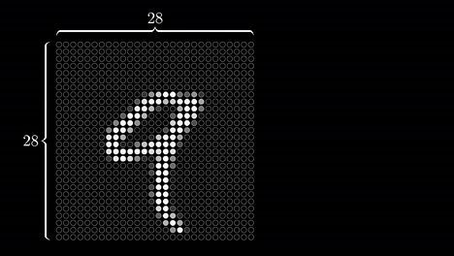
Review: Hand write recognition

Slide 3
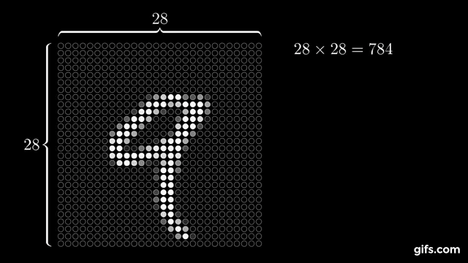
Example: Hand write recognition

Slide 4
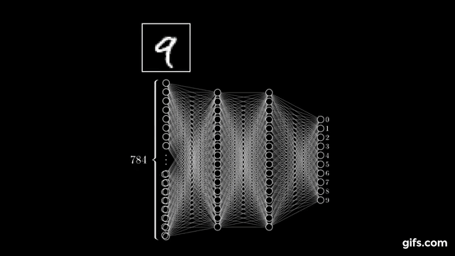
Review: Hand write recognition

Slide 5
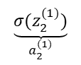
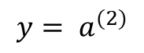
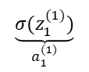
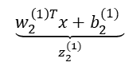
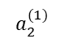
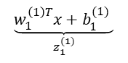
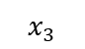
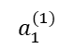
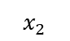
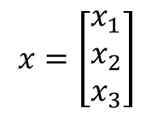
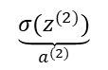
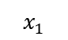
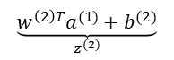
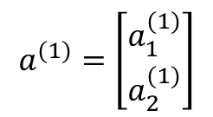
Review- General NN
$$x=\left[\begin{matrix}x_{1} \\ x_{2} \\ x_{3}\end{matrix}\right]$$
$$a^{(1)}=\left[\begin{matrix}a_{1}^{(1)} \\ a_{2}^{(1)}\end{matrix}\right]$$
$$\underset{z_{1}^{(1)}}{\underbrace{w_{1}^{\left(1\right)T}x+b_{1}^{(1)} }}$$
$$\underset{a_{1}^{(1)}}{\underbrace{σ(z_{1}^{(1)})}}$$
$$x_{1}$$
$$a_{1}^{(1)}$$
$$\underset{a^{(2)}}{\underbrace{σ(z^{(2)})}}$$
$${y= a}^{(2)}$$
$$\underset{z^{(2)}}{\underbrace{w^{\left(2\right)T}a^{(1)}+b^{(2)}}}$$
$$x_{2}$$
$$\underset{a_{2}^{(1)}}{\underbrace{σ(z_{2}^{(1)})}}$$
$$a_{2}^{(1)}$$
$$\underset{z_{2}^{(1)}}{\underbrace{w_{2}^{\left(1\right)T}x+b_{2}^{(1)} }}$$
$$x_{3}$$
Concepts: Neuron(node), Activation function, weight, bias

Slide 6
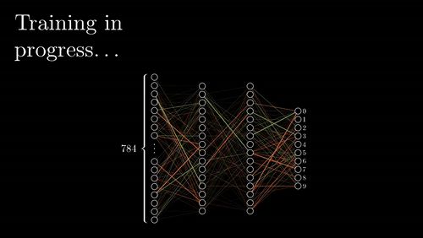
Learning
Now that we learnt structure of neural network, the question is that how to find the parameters?

Slide 7
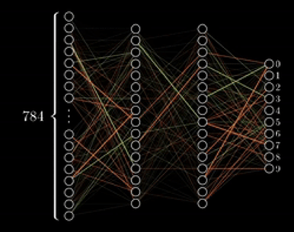
Learning
How many parameters do we have?
Weights: 784*16+16*16+16*10 = 12,960
Biases: 16+16+10 = 42
Total number of parameters: 13,002

Slide 8
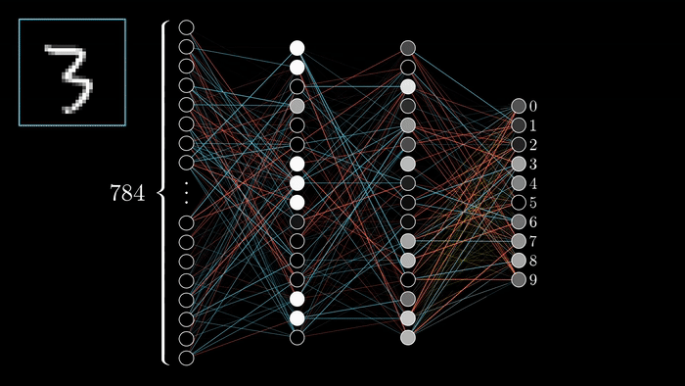
Learning
We start with choosing the weights and bias completely randomly.
Some undesired outputs are activated too.

Slide 9
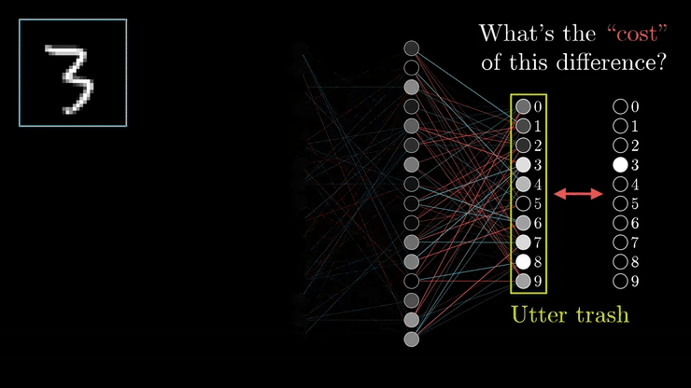
Learning
What does it mean mathematically?
Remember that we have many training values so we should compute the average of this cost.

Slide 10

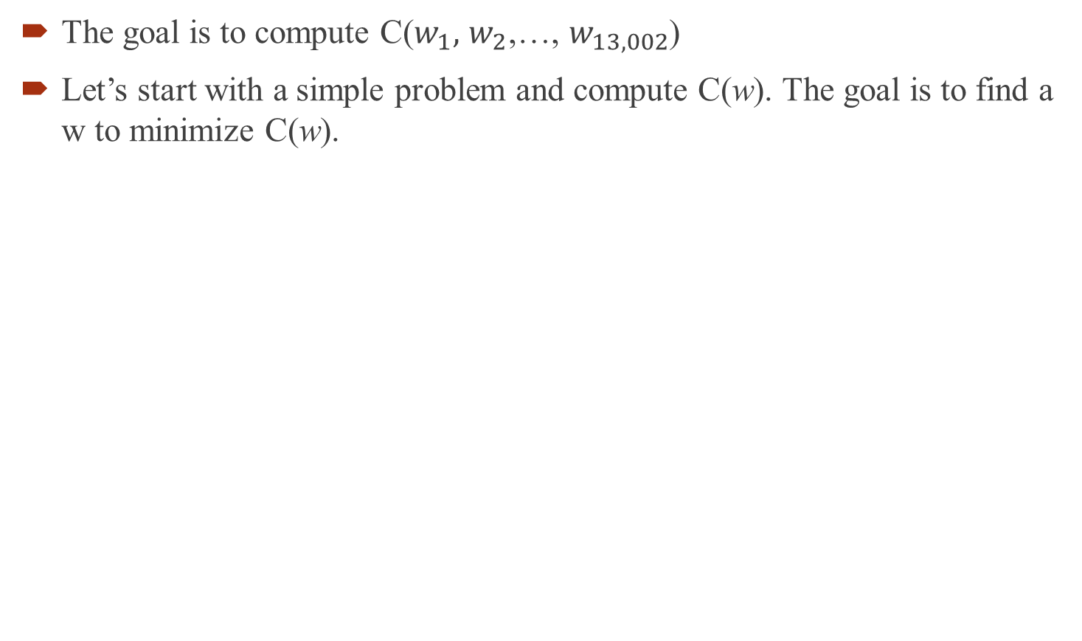
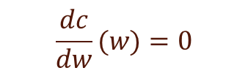
Cost function
The goal is to compute C($w_{1},$ $w_{2}$,…, $w_{13,002}$)
Let’s start with a simple problem and compute C(w). The goal is to find a w to minimize C(w).
If the problem is that easy:
C(w)
$$\frac{dc}{dw}(w)=0$$
$$w_{min}$$

Slide 11

Cost function
Usually the problem is not that easy and straight forward
We can start from a random point and move to right or left
C(w)
$$w_{min}$$

Slide 12
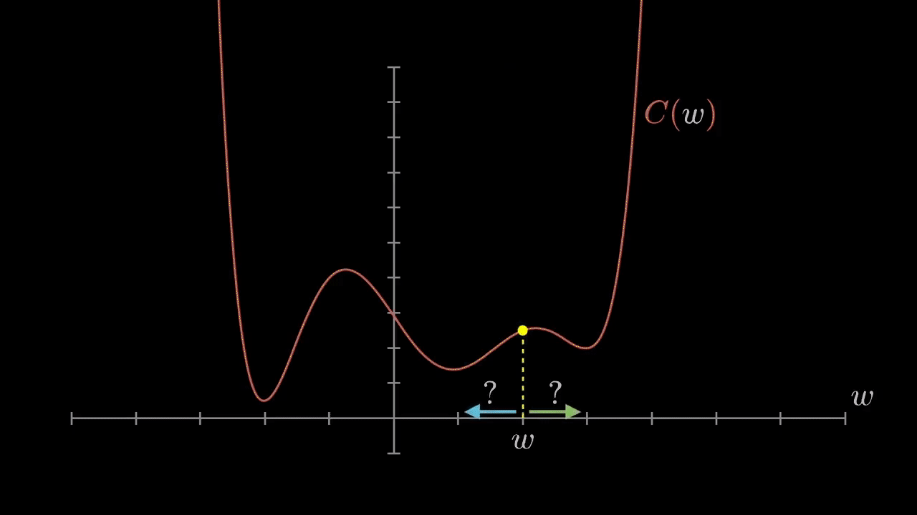
Cost function
Now we should figure out which direction we should go to lower the cost
Shift to left if the slope is positive
tangential

Slide 13
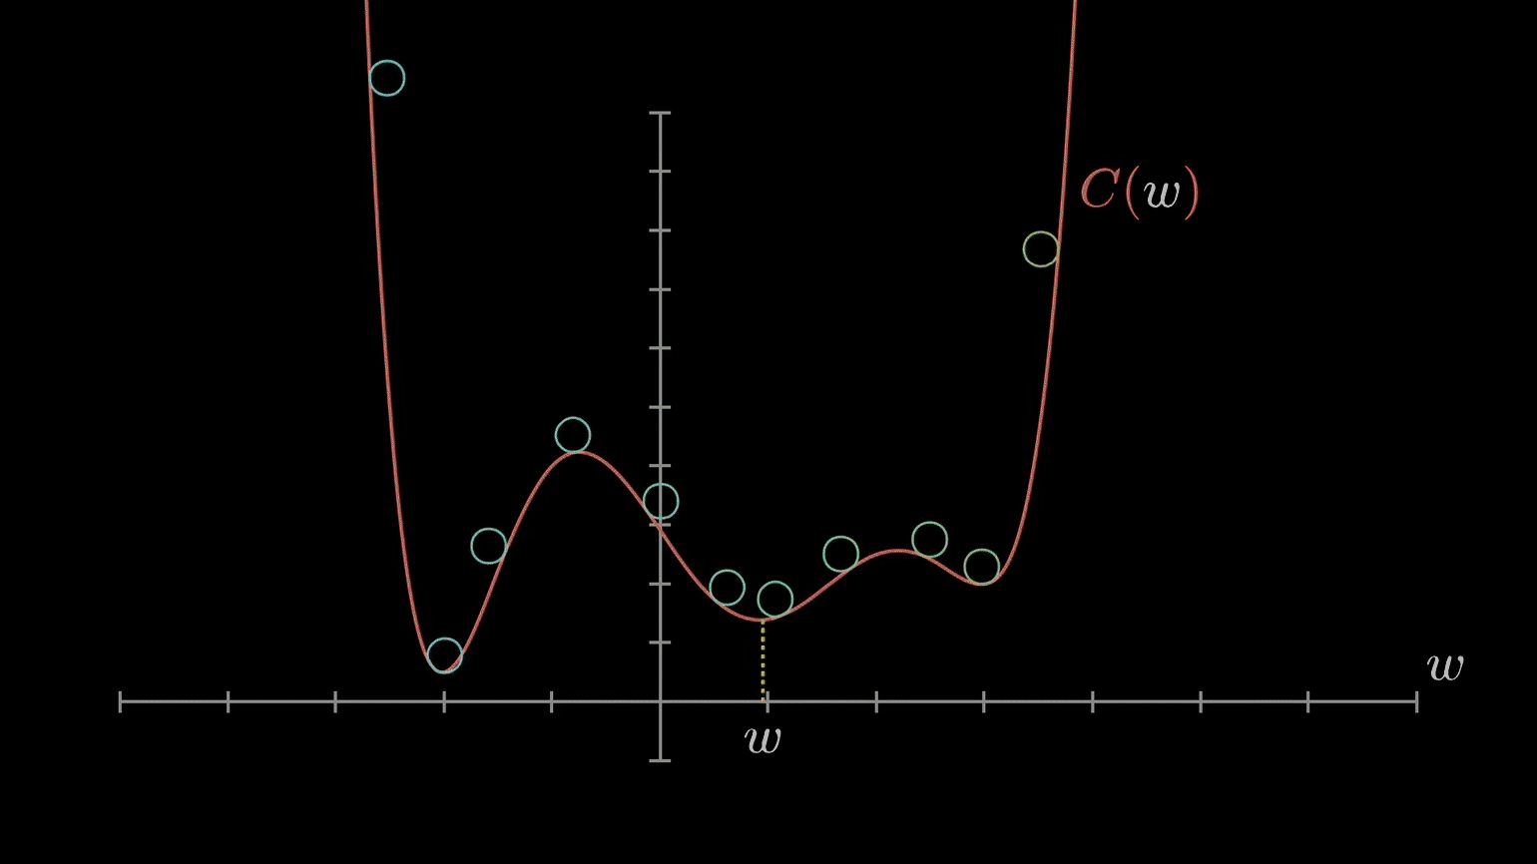
Cost function
It is like rolling down some balls

Slide 14
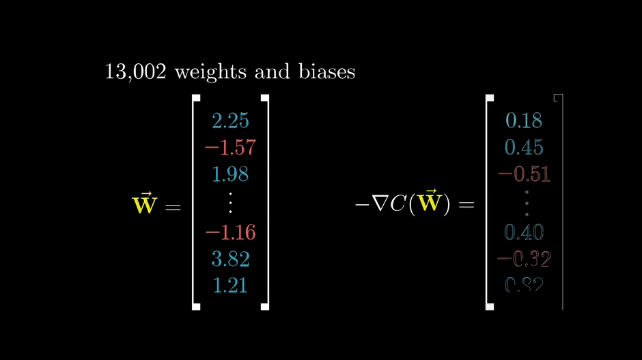
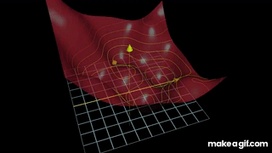
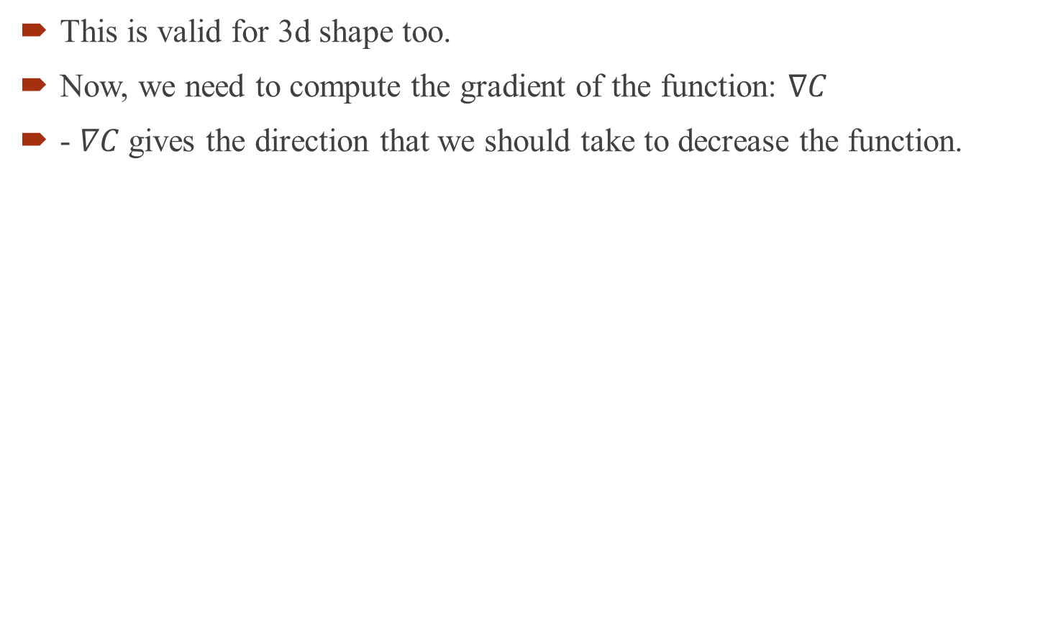
Cost function
Pay attention to the magnitude of each number- Does it show how sensitive this parameter is to the changes?
This is valid for 3d shape too.
Now, we need to compute the gradient of the function: $∇C$
- $∇C$ gives the direction that we should take to decrease the function.

Slide 15
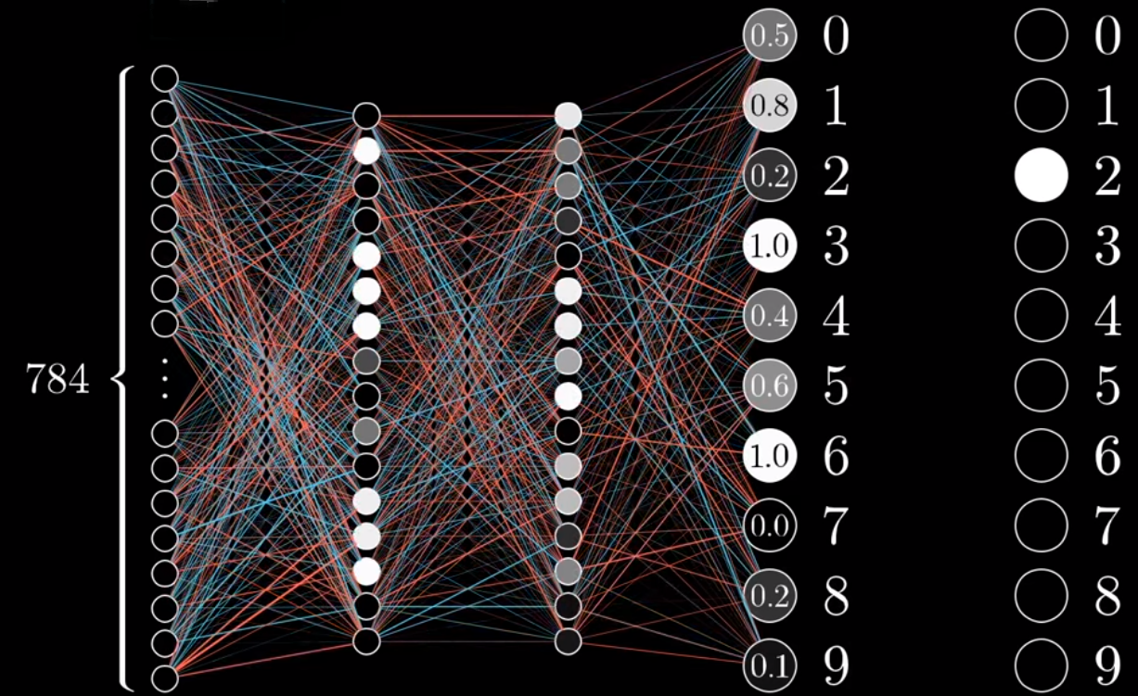
Back propagation
Backpropagation is a method used in artificial neural networks to calculate a gradient that is needed in the calculation of the weights to be used in the network.

Slide 16
Back propagation
Let’s see how each neuron should be changed compared to actual label.
We can zoom in one of the neurons (maybe 2 which is the most important one)

Slide 17
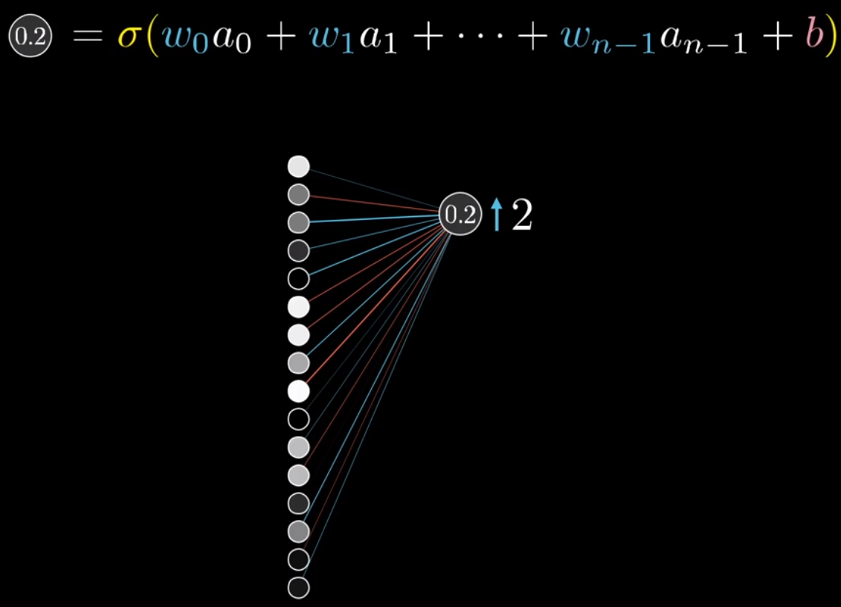
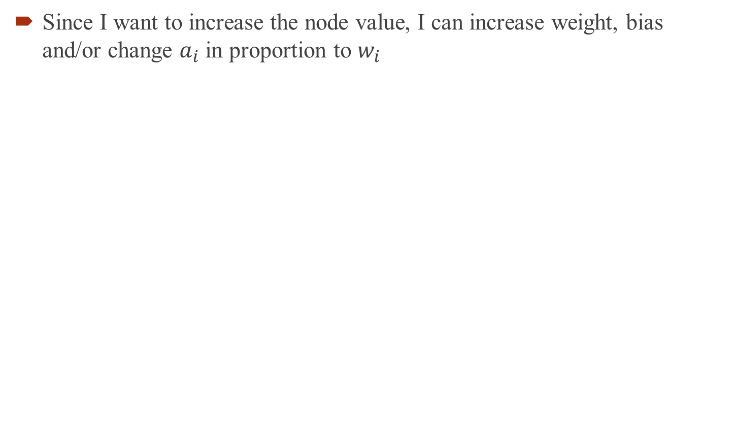
Back propagation
Since I want to increase the node value, I can increase weight, bias and/or change $a_{i}$ in proportion to $w_{i}$

Slide 18
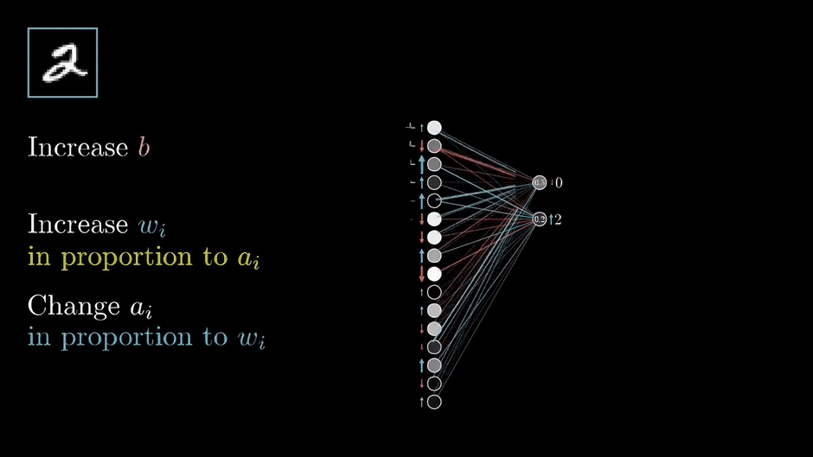
Back propagation
This is valid for all the output neurons
This is called propagate backward

Slide 19
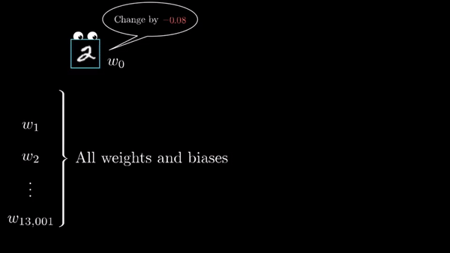
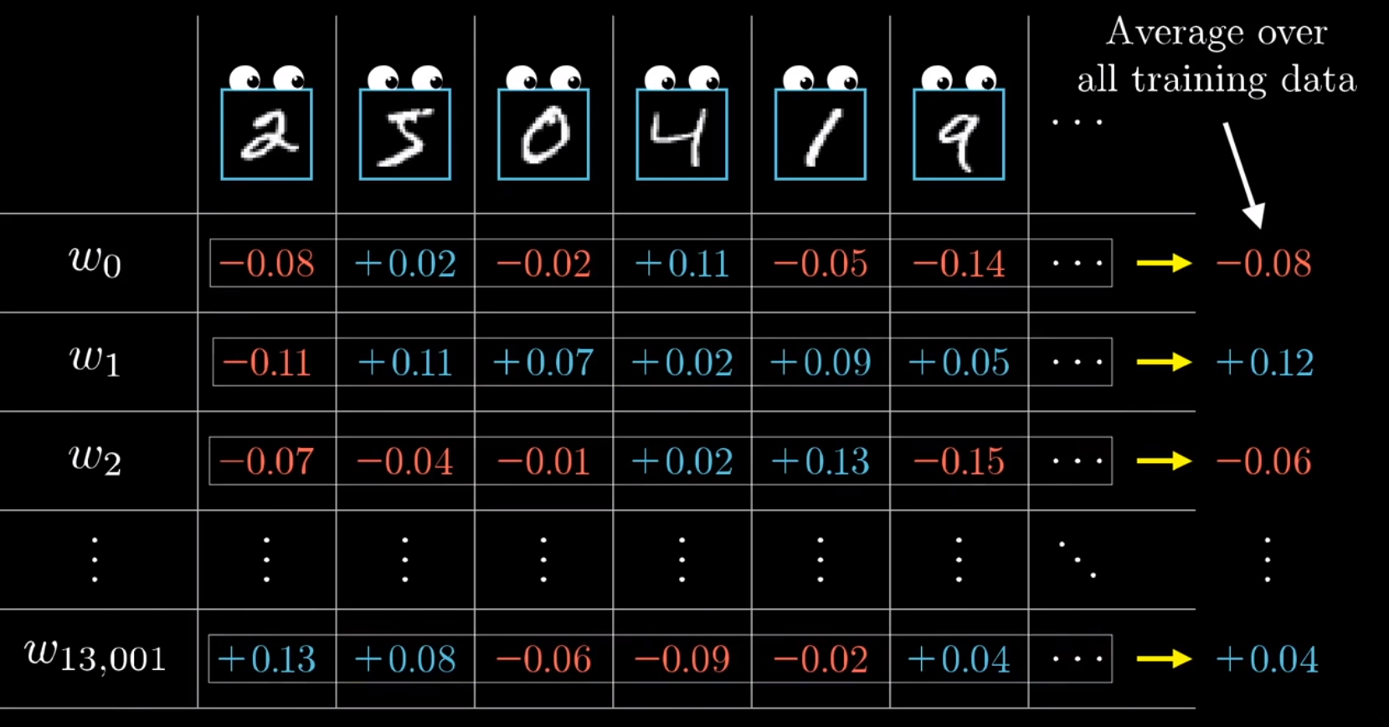
Back propagation
Let’s put all the results in one table

Slide 20
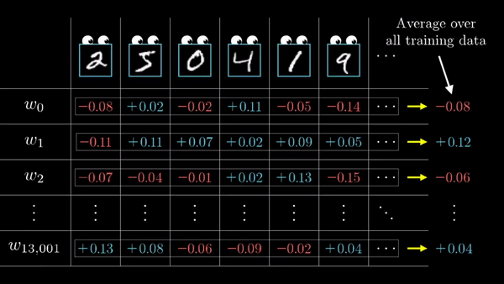
Back propagation
And this is how gradient is related to these numbers:

Slide 21
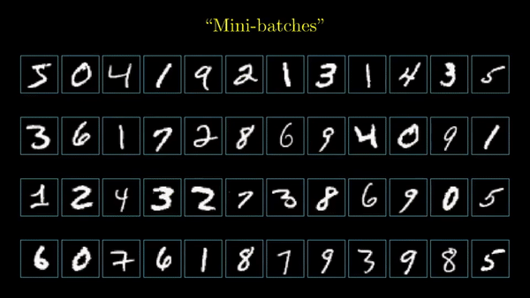
Stochastic Gradient Descent
Using GD is time consuming.
SGD randomly picks one data point from the whole data set at each iteration to reduce the computations enormously.
It is also common to sample a small number of data points instead of just one point at each step and that is called “mini-batch” gradient descent. Mini-batch tries to strike a balance between the goodness of gradient descent and speed of SGD.

Slide 22
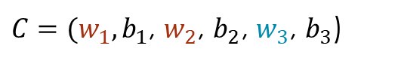
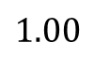
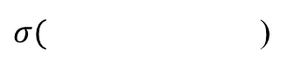
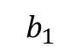
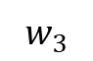
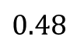
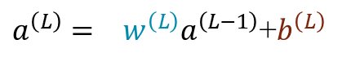
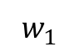
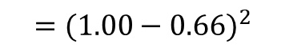
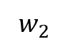
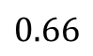
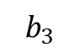
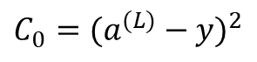
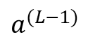




Back propagation- simple model
Let’s start with a very simple network
These are the weights and biases. Let’s see how sensitive the network is to each of these parameters.
For now, let’s just focus on last two neurons.
$C=(w_{1},b_{1}$, $w_{2}$, $b_{2}$, $w_{3}$, $b_{3}$)
$$w_{1}$$
$$w_{2}$$
$$b_{1}$$
$$b_{2}$$
$$b_{3}$$
$$0.48$$
$$w_{3}$$
$$1.00$$
$$0.66$$
$$a^{(L−1)}$$
$$a^{(L)}$$
$$y$$
Desired output
$$σ (z^{\left(L\right)})$$
Cost
$$C_{0}=(a^{(L)}−y)^{2}$$
$$=(1.00−0.66)^{2}$$
$a^{\left(L\right)}={{ w}^{\left(L\right)}a}^{\left(L−1\right)}$+$b^{\left(L\right)}$
Remember:
$σ($ )

Slide 23

Back propagation- simple model
We want to see the effect of weight on cost function.
How about the other parameters?

Slide 24


Back propagation- simple model
Conceptually, small change in $w^{\left(L\right)}$ will affect $z^{\left(L\right)}$
On the other hand, change in $z^{\left(L\right)}$ will affect change on $a^{(L)}$

Slide 25

Back propagation- simple model
Let’s compute all the derivatives.
This shows the relationships between all the variables

Slide 26






Back propagation- simple model
Let’s compute all the derivatives.
We need to average over all the training examples:
This is just one component of the whole derivative of cost function:
$$\frac{∂C_{0}}{∂w^{\left(L\right)}}=\frac{∂z^{(L)}}{∂w^{\left(L\right)}}\frac{∂a^{(L)}}{∂z^{(L)}}\frac{∂C_{0}}{∂a^{(L)}}$$
$$=a^{\left(L−1\right)}\acute{σ}\left(z^{\left(L\right)}\right)2(a^{\left(L\right)}−y)$$
$$\frac{∂C}{∂w^{\left(L\right)}}=\frac{1}{n}\sum_{k=0}^{n−1}{\frac{∂C_{k}}{∂w^{\left(L\right)}}}$$
$$∇C=\left[\begin{matrix}\begin{matrix}\begin{matrix}\frac{∂C}{∂w^{\left(1\right)}} \\ \frac{∂C}{∂b^{\left(1\right)}}\end{matrix} \\ ⋮\end{matrix} \\ \frac{∂C}{∂w^{\left(L\right)}} \\ \frac{∂C}{∂b^{\left(L\right)}}\end{matrix}\right]$$
$$\frac{∂C_{0}}{∂b^{\left(L\right)}}=\frac{∂z^{(L)}}{∂b^{\left(L\right)}}\frac{∂a^{(L)}}{∂z^{(L)}}\frac{∂C_{0}}{∂a^{(L)}}=\acute{σ}\left(z^{\left(L\right)}\right)2(a^{\left(L\right)}−y)$$
Now the question is, how sensitive the cost function is to the previous activation?
$$\frac{∂C_{0}}{∂a^{\left(L−1\right)}}=\frac{∂z^{(L)}}{∂a^{\left(L−1\right)}}\frac{∂a^{(L)}}{∂z^{(L)}}\frac{∂C_{0}}{∂a^{(L)}}=w^{\left(L\right)}\acute{σ}\left(z^{\left(L\right)}\right)2(a^{\left(L\right)}−y)$$
So we can use this methodology to find the sensitivity to all the neurons.

Slide 27

















Back propagation
How about when we have more neurons? Pay attention to notations
Let’s look at one layer
Now Cost function of last layer will be:
Now to make a better view, let’s call the weight from neuron k to neuron j: $w_{jk}^{\left(L\right)}$
$$C_{0}=\sum_{j=0}^{n_{L}−1}{(a_{j}^{\left(L\right)}−y_{j})^{2} }$$
$$z_{j}^{(L)}=w_{j0}^{(L)}a_{0}^{(L−1)}+w_{j1}^{(L)}a_{1}^{(L−1)}+w_{j2}^{(L)}a_{2}^{(L−1)}+b_{j}^{(L)}$$
$$a_{j}^{(L)}=σ(z_{j}^{(L)})$$
$$a_{0}^{(L−1)}$$
$$0.10$$
$$a_{j}^{(L)}$$
$$0.81$$
$$a_{0}^{(L)}$$
$$\frac{∂C_{0}}{∂w_{jk}^{(L)}}=\frac{∂z_{j}^{(L)}}{∂w_{jk}^{(L)}}\frac{∂a_{j}^{(L)}}{∂z_{j}^{(L)}}\frac{∂C_{0}}{∂a_{j}^{(L)}}$$
$$a_{1}^{(L−1)}$$
$$a_{k}^{(L−1)}$$
$$0.40$$
$$0.40$$
$$a_{1}^{(L)}$$
$$\frac{∂C_{0}}{∂a_{k}^{(L−1)}}=\sum_{j=0}^{n_{L}−1}{\frac{∂z_{j}^{(L)}}{∂a_{k}^{(L−1)}}\frac{∂a_{j}^{(L)}}{∂z_{j}^{(L)}}\frac{∂C_{0}}{∂a_{j}^{(L)}}}$$
$$a_{2}^{(L−1)}$$
$$0.81$$
What is changed though?

Slide 28



Back propagation
In conclusion:
$$\frac{∂C}{∂w_{jk}^{(l)}}=a_{k}^{(l−1)}\acute{σ}(z_{j}^{(l)})\frac{∂C}{∂a_{k}^{(l)}}$$
$$\sum_{j=0}^{n_{l+1}−1}{w_{jk}^{(l+1)}\acute{σ}(z_{j}^{(l+1)}) \frac{∂C}{∂a_{k}^{(l+1)}}}$$
or
$$2\left(a_{j}^{\left(L\right)}−y_{j}\right)$$

Slide 29
Assignment 2
A python code for backpropagation is uploaded on Canvas. Please go over the code and write one page report about all the functions and classes that you see in code.
Class: Network
Functions: feedforward, SGD, update_mini_batch, backprop, evaluate, cost_derivative, sigmoid, sigmoid_prime

Slide 30

Learning with gradient descent
For this lecture we will use the MNIST data set: http://yann.lecun.com/exdb/mnist/
The MNIST data comes in two parts. The first part contains 60,000 images to be used as training data. These images are scanned handwriting samples from 250 people. The images are greyscale and 28 by 28 pixels in size.
The second part of the MNIST data set is 10,000 images to be used as test data. Again, these are 28 by 28 greyscale images.
Each training input x is a 28×28=784-dimensional vector. We'll denote the corresponding desired output by y=y(x), where y is a 10-dimensional vector. For example, if a particular training image, x, depicts a 6, then y(x)=(0,0,0,0,0,0,1,0,0,0$)^{T}$ is the desired output from the network.

